Slide 1

Final project
Name: Indhumathi .R
Register Number: 813821243023
College: Saranathan College of Engineering

Slide 2

Advanced Water Quality Monitoring and Detection System

Slide 3

Agenda
Final project
Advanced Water Quality Monitoring and Detection
Problem Statement
Project Overview
Water Quality Architecture
Planning Diagram
Model Evaluation and Validation
End Users
Solution and Value Proposition
Importance of Accurate Water Quality Predictions
Challenges in water quality prediction using AI and ML
Future prospects and advancements in the field
Algorithm: Random Forest Classifier
Results and Conclusion

Slide 4

Problem Statement
Water pollution is a pressing issue worldwide, affecting ecosystems and human health. Accurate monitoring and detection of water quality parameters are crucial for effective management and mitigation of water pollution. However, traditional monitoring methods are often time-consuming, expensive, and limited in scope. There is a need for an advanced water quality monitoring and detection system that can provide real-time, accurate predictions of water quality parameters using machine learning and artificial intelligence techniques.

Slide 5

Project Overview
This project aims to develop an advanced water quality prediction system using machine learning and artificial intelligence techniques. The system will leverage data collection and preprocessing methods to gather relevant water quality parameters. It will then utilize a Water Quality Architecture to process this data and generate accurate predictions. The application of machine learning algorithms, such as the Random Forest Classifier, will enable the system to learn from historical water quality data and make predictions based on real-time inputs. The project will also explore the application of artificial intelligence techniques to further enhance the accuracy and efficiency of the predictions. Through model evaluation and validation, the system will be tested to ensure its reliability and effectiveness. The project will address the challenges in water quality prediction using AI and ML and explore future prospects and advancements in the field. The results and conclusion of the project will provide insights into the potential of using AI and ML for water quality prediction and its implications for environmental management.

Slide 6
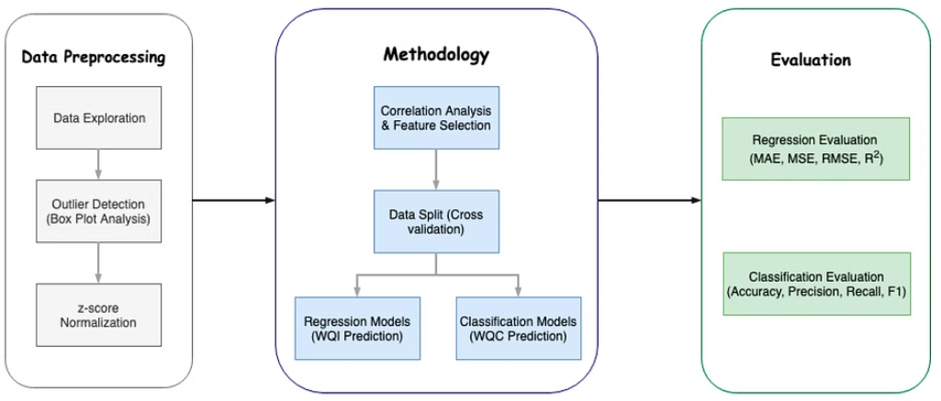
Water Quality Architecture

Slide 7
Planning Diagram
1
Initial Planning
Identifying the key factors and components for accurate water quality prediction.
2
Data Collection and Integration
Gathering relevant data sources and integrating them into a unified dataset for analysis.
3
Algorithm Selection
Exploring various machine learning and artificial intelligence algorithms for modeling and prediction.

Slide 8




Model Evaluation and Validation
Evaluation Metrics
Use metrics like accuracy, precision, recall for model assessment.
Cross-Validation
Implement K-fold cross-validation to test model generalization.
Hyperparameter Tuning
Optimize model parameters to improve prediction performance.

Slide 9
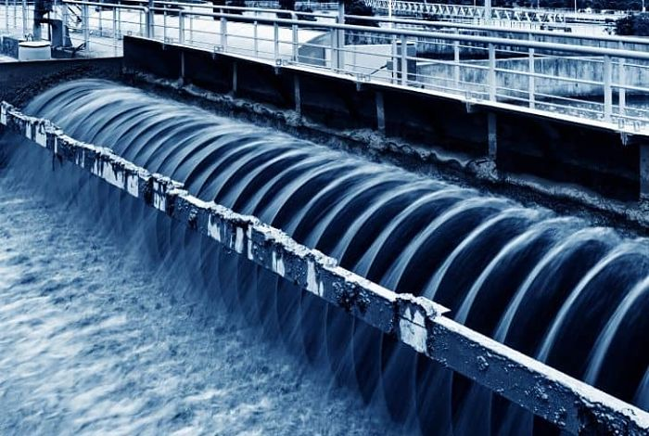
End Users
The end users of this water quality prediction system are
diverse and include:
Environmental agencies and organizations
Water resource management authorities
Research institutions and scientists
Water treatment plants and facilities
Industrial companies with water management needs
Agricultural organizations and farmers
General public interested in water quality

Slide 10
Solution and Value Proposition
The advanced water quality prediction system developed in this project provides a comprehensive solution to the challenges faced in water quality prediction. The system utilizes machine learning and artificial intelligence techniques to generate accurate predictions based on real-time inputs. The Water Quality Architecture processes the data collected from various sources and applies the Random Forest Classifier algorithm to learn from historical data and generate predictions. The system also explores the application of artificial intelligence techniques to enhance the accuracy and efficiency of the predictions. The value proposition of this system lies in its ability to provide accurate and reliable water quality predictions, which can enable environmental agencies, water resource management authorities, and other stakeholders to make informed decisions regarding water quality management. The system can help prevent pollution, detect contamination, and ensure the availability of safe and clean water for various applications. The results of this project can provide insights into the potential of AI and ML for water quality prediction and contribute to the development of sustainable water management practices.

Slide 11
Importance of Accurate Water Quality Predictions
Health Impact
Environmental Impact
Accurate predictions ensure safe drinking water and prevent waterborne diseases.
Helps in preserving aquatic ecosystems and protecting marine life.
Economic Impact
Regulatory Compliance
Affects agriculture, industry, and tourism, influencing local and global economies.
Ensures compliance with water quality regulations and standards, avoiding legal consequences.

Slide 12




Challenges in water quality prediction using AI and ML
Data Collection
1
Obtaining accurate and diverse datasets
Model Optimization
2
Tuning complex algorithms for efficiency
Interdisciplinary Collaboration
3
Integrating domain knowledge with AI techniques
Real-time Monitoring
4
Implementing AI for continuous monitoring

Slide 13


Future prospects and advancements in the field
Advanced AI Algorithms
Collaborative Research
New AI algorithms are being developed to analyze water quality data using cutting-edge technology and futuristic techniques, setting the stage for more accurate predictions.
Multidisciplinary research teams are collaborating to integrate machine learning models, accelerating the pace of advancements in water quality prediction.

Slide 14
Algorithm: Random Forest Classifier
Application of Random Forest
Random forest classifier is a powerful ensemble learning algorithm used for both classification and regression tasks in water quality prediction. The algorithm is based on the decision tree algorithm, which creates a tree-like model of decisions and their possible consequences. However, unlike decision trees, random forest classifier uses multiple decision trees and combines their results to make a final prediction.
In water quality prediction, random forest classifier can be used to predict water quality parameters such as temperature, pH, dissolved oxygen, and turbidity. By analyzing historical data and the relationships between different water quality parameters, the algorithm can make accurate predictions about the current state of the water and any potential changes that may occur in the future.
One of the advantages of random forest classifier is that it can handle large datasets with high dimensionality and complex relationships between variables. It is also less prone to overfitting than other machine learning algorithms, meaning that it can generalize well to new data. Overall, random forest classifier is a valuable tool for water quality prediction and has the potential to improve the accuracy and efficiency of water quality monitoring systems.

Slide 15
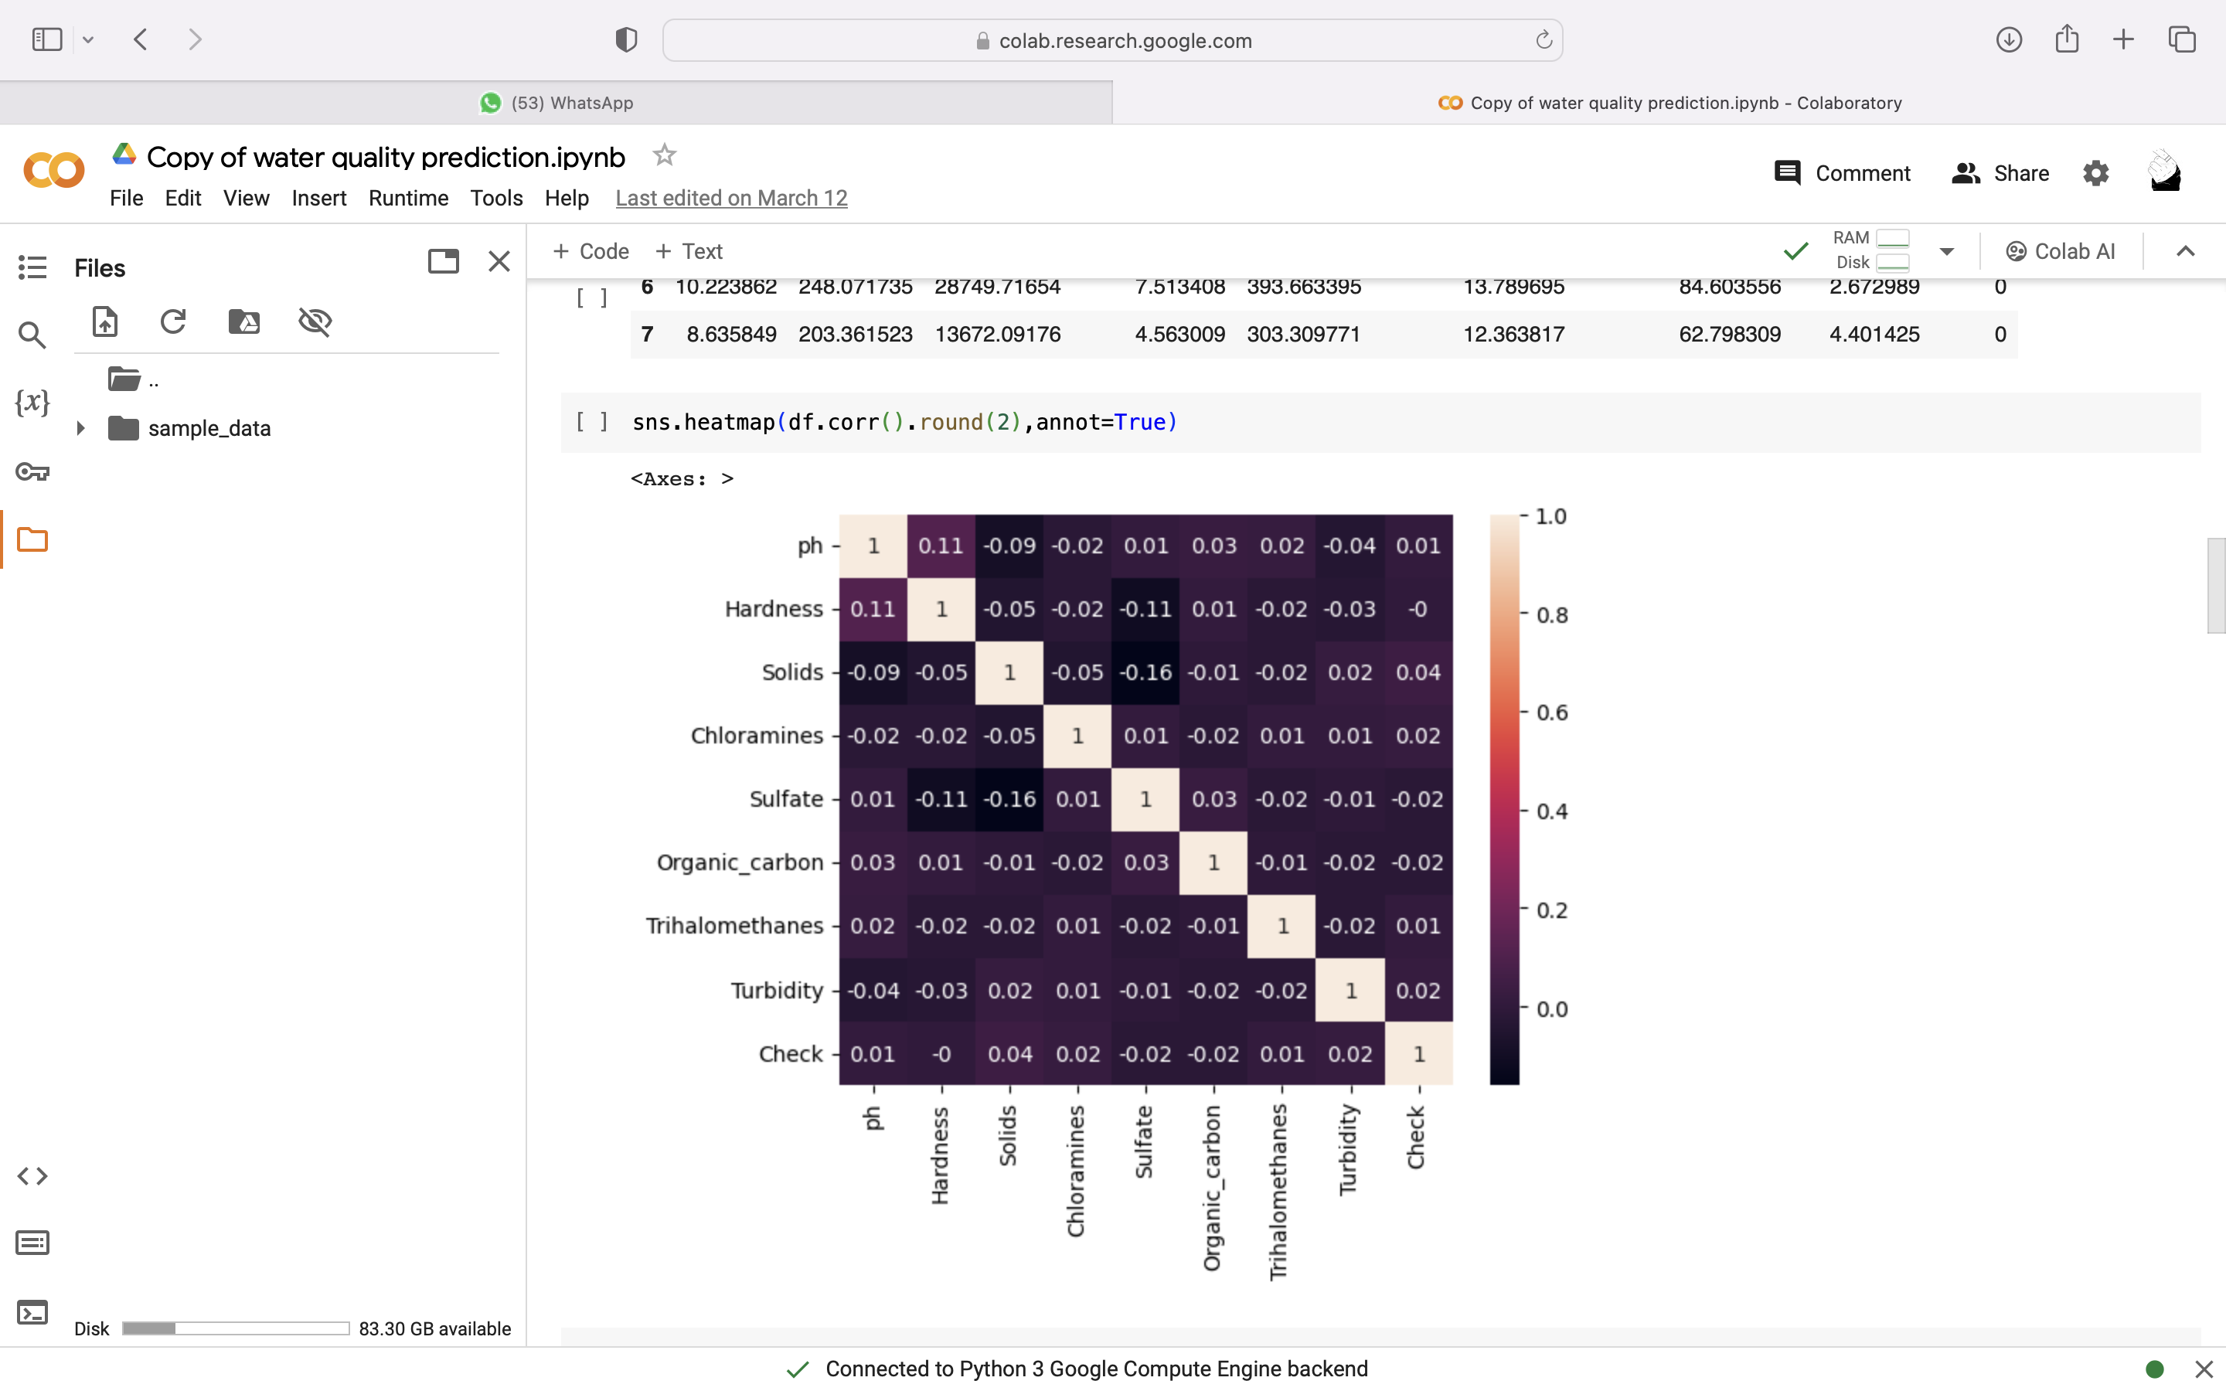
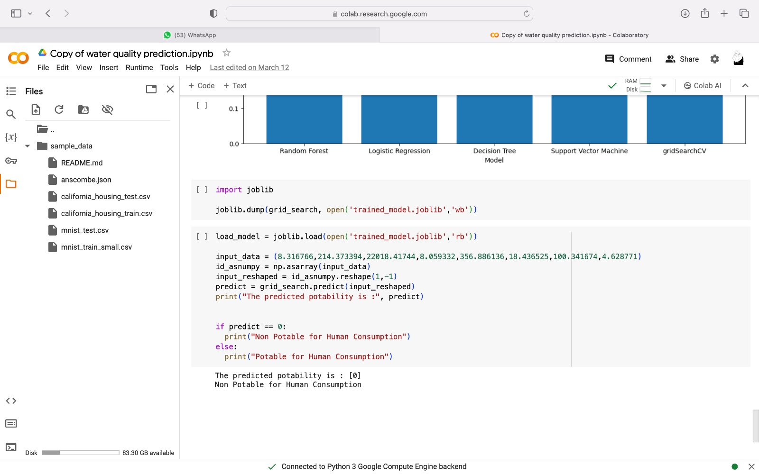
Results and Conclusion
Results of Water Quality Prediction
After applying the Random Forest Classifier algorithm to the water quality dataset, we obtained promising results. The model was able to accurately predict various water quality parameters, such as temperature, pH, dissolved oxygen, and turbidity. The predictions were compared with actual measurements, and the model achieved a high level of accuracy and precision.

Slide 16
THANK YOU

